Slide 1
On the Robotic Uncertainty of Fully Autonomous Traffic
LI, Hangyu
hangyu.li@connect.ust.hk
Advised by Dr. SUN, Xiaotong
CTS2022 August 15-16
Intelligent Transportation Thrust
Systems Hub, HKUST(GZ)

Slide 2
Contents
Introduction
Model
Scenario statement
Safety evaluation
Average collision-inclusive capacity
Discussion
Influence of parameters
Suggested control on variables
Generalization of the model
Conclusion
2

Slide 3
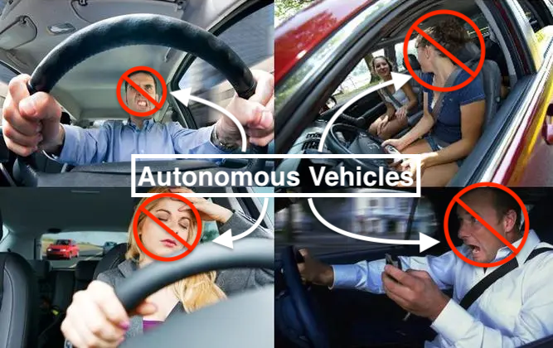
1. Introduction
Human Driven Vehicles:
Accidents caused by human errors (main cause of car crashes)
Congestion propagation due to the heterogeneity of driver intentions
Autonomous Vehicles (assumed):
Intelligent decision-making abilities
Accurate machinery operations
Shorter stable headway
Increased roadway capacity
AVs offer the potential to improve both traffic safety and efficiency.
3

Slide 4
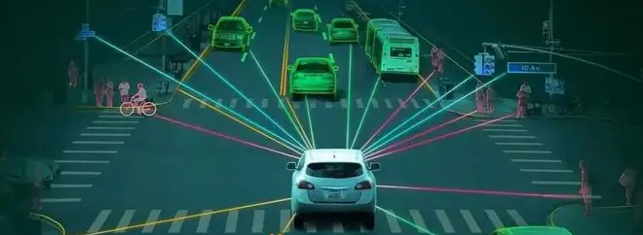
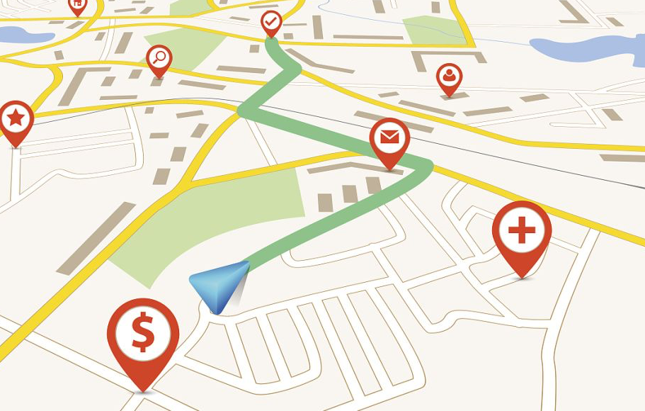
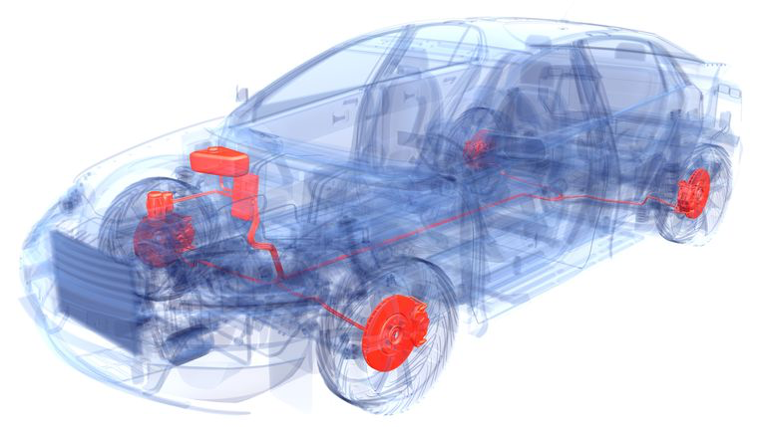
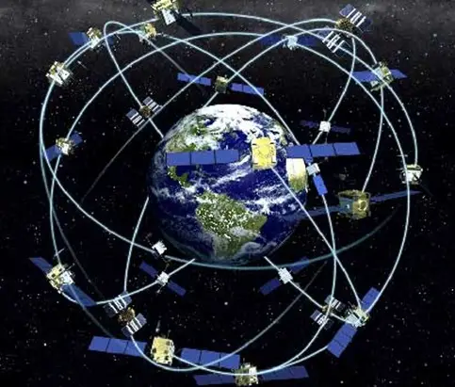
1. Introduction
AVs
with
ERROR
Perception
Localization
Planning
Control
AVs
4

Slide 5
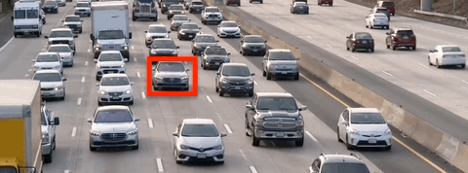
1. Introduction
Perception algorithms
Fusion localization
Control strategies
Development
Ensure stability but neglect traffic benefits
Focus on safety but sacrifice efficiency
Validation
Uncertainty
Lack of laws and rules
Public concerns
5

Slide 6
1. Introduction
Fully autonomous traffic
OUR MODEL
Rear-end
collision rate
Collision Probability
Collision-inclusive
capacity
Two-state stochastic process
Car-following Scenario
Normal
Blocked
6

Slide 7
2. Model - Scenario
Forward perception – only follow the certain car in front
Longitudinal control – only acceleration and braking are considered
Rear-end collision – consider single-lane one-time rear-end collisions as the only source of capacity reduction
Predetermined speed – view speed as an exogenous variable independent of traffic density
Ideal road section – Independent section has no bottleneck at the downstream
7

Slide 8
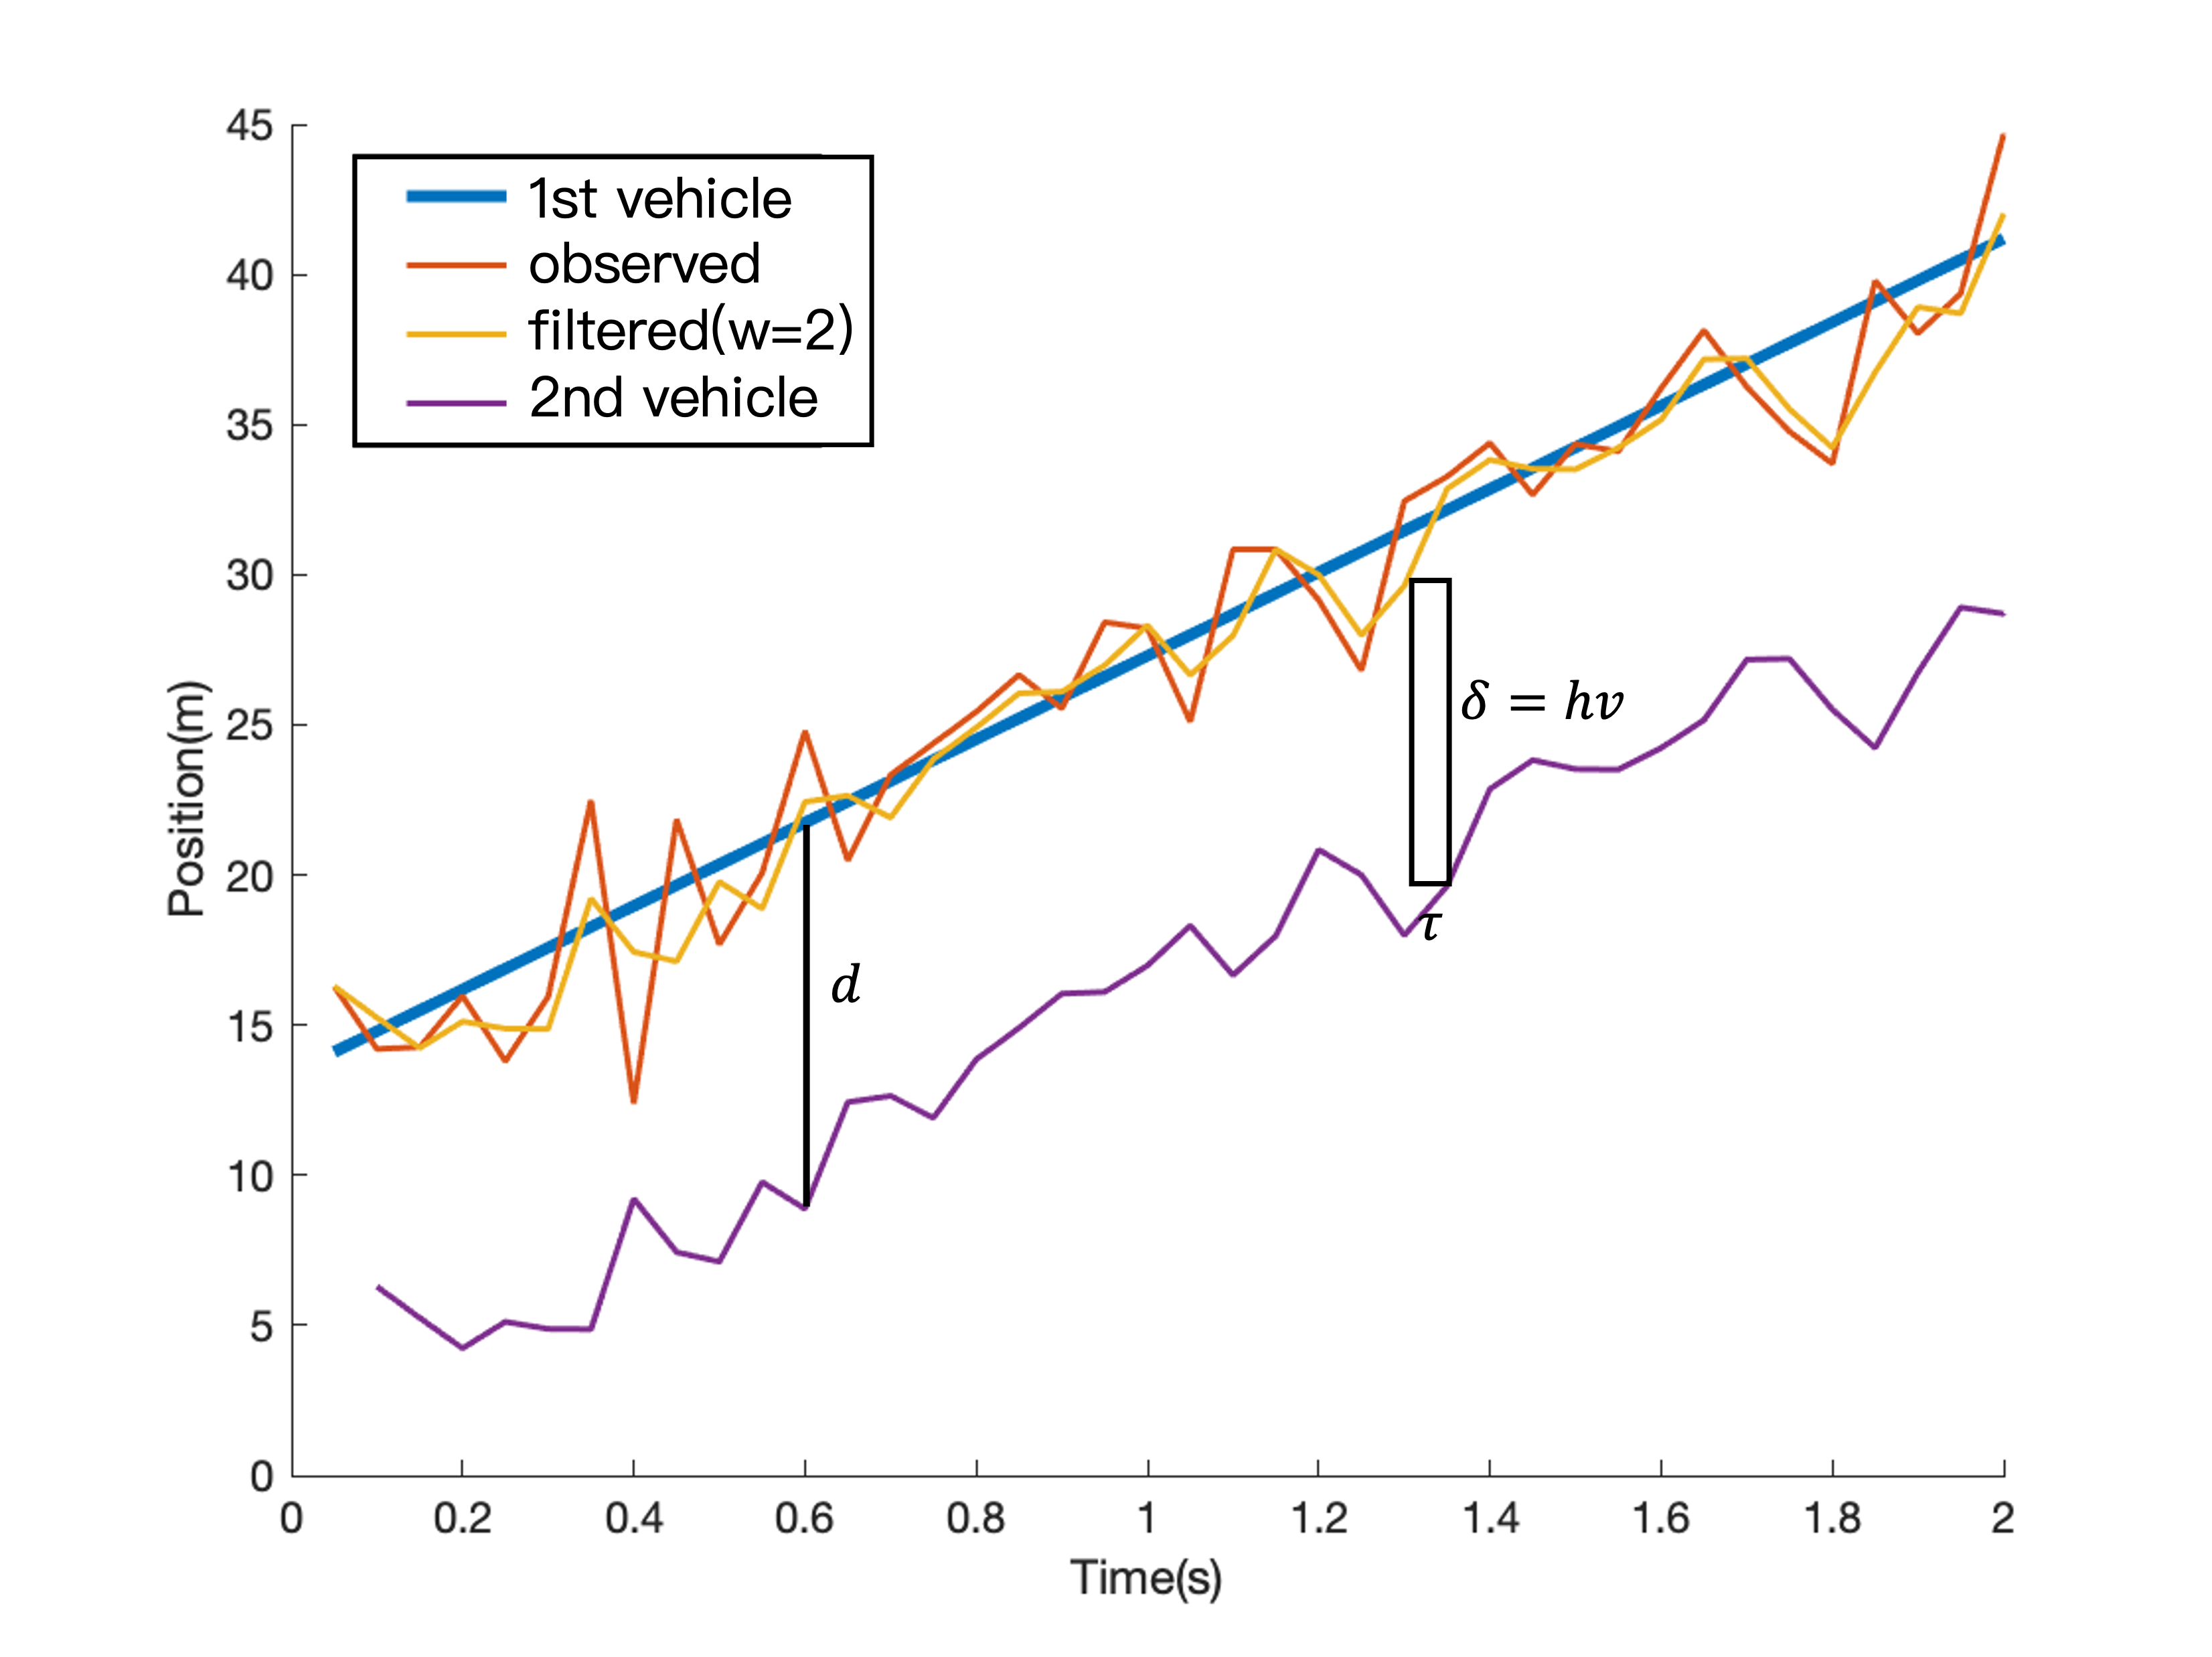
2. Model – Car following with perceptual error
Newell’s model:
with perceptual error:
8

Slide 9
2. Model – Error propagation
When ego vehicle (e) follows
the front stochastic vehicle (f)
with observation error (o)
When randomness stabilizes,
stochasticity of each vehicle converges
and
distance (d) becomes time-invariant
9

Slide 10
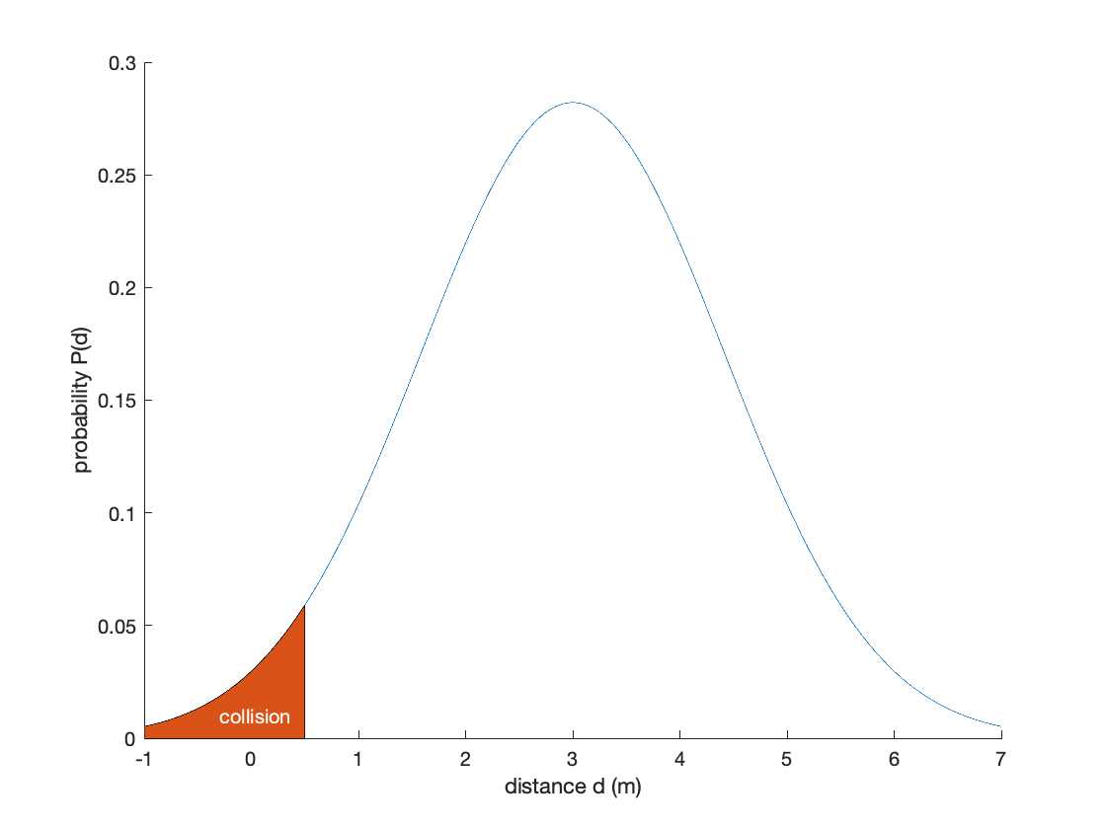
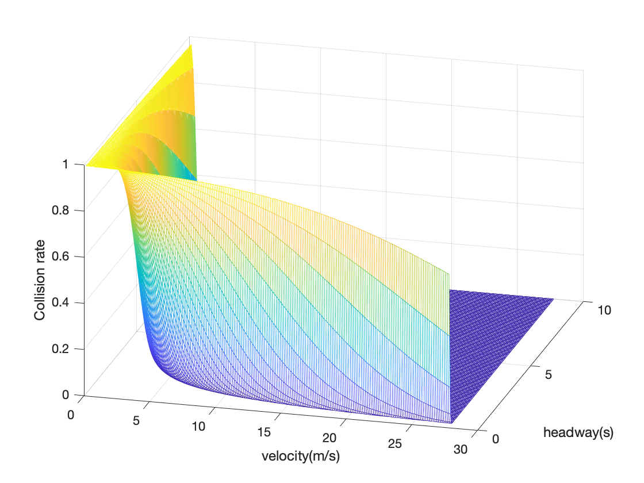
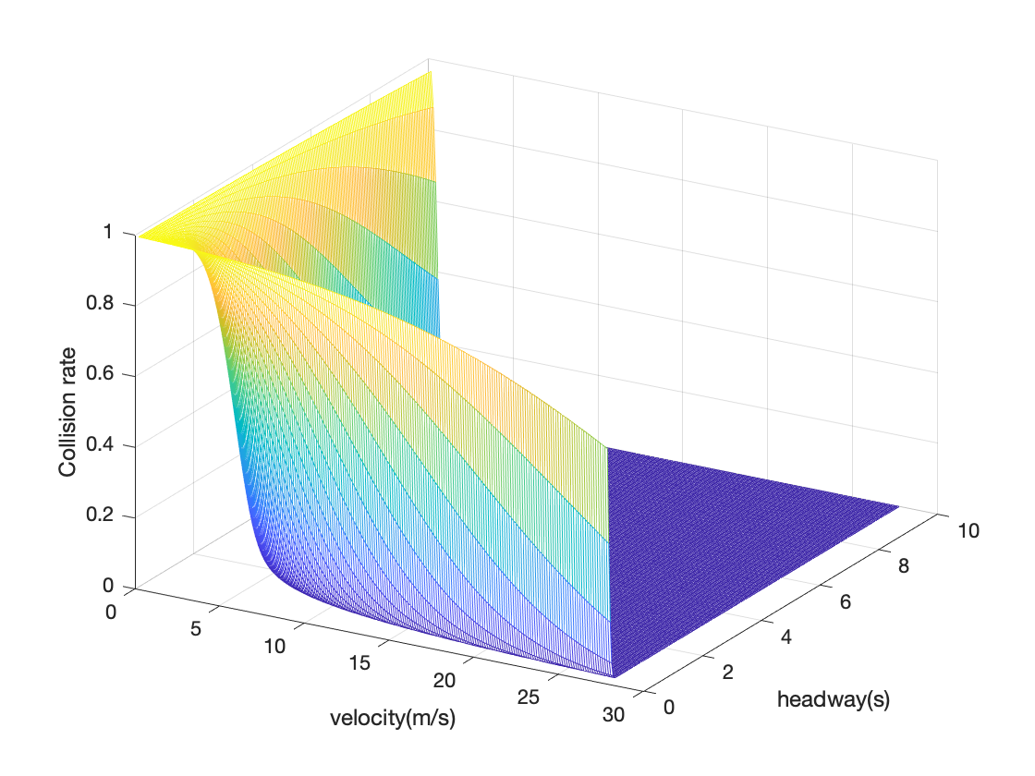
2. Model – Safety measurement
Collision
Region
Safe Region
Possible Positions
Front Vehicle
Supposed Position
10

Slide 11
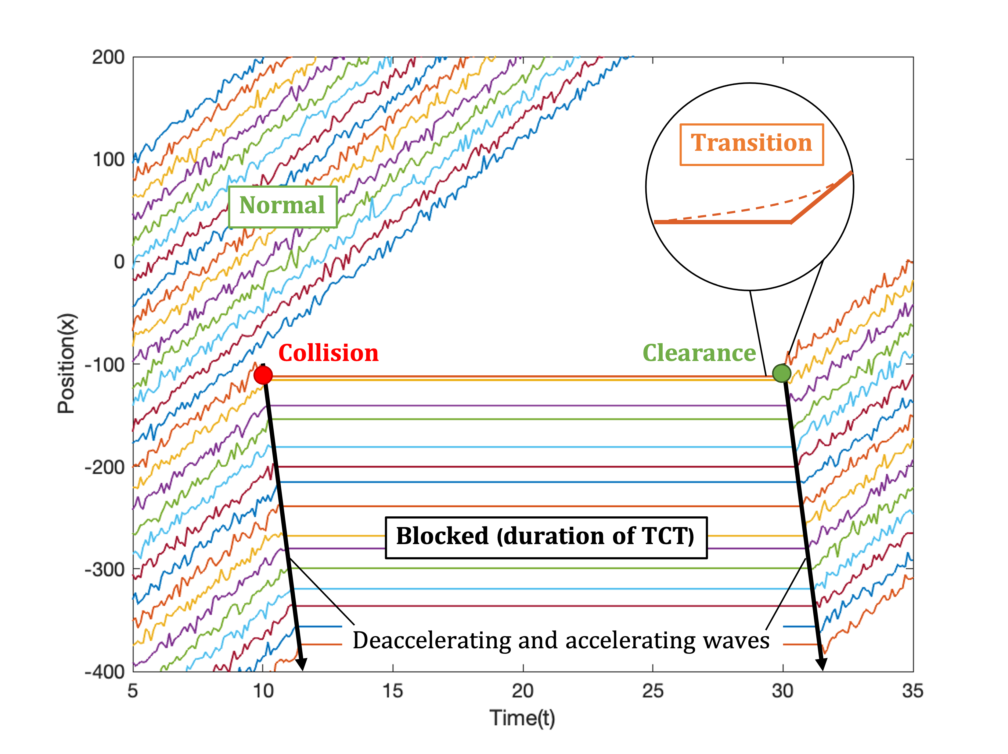
2. Model – Collision-inclusive capacity
Normal
(normal capacity)
Blocked (duration of TCT)
(zero capacity)
(reduced flow per collision)
Transitions
Collision
Clearance
11

Slide 12
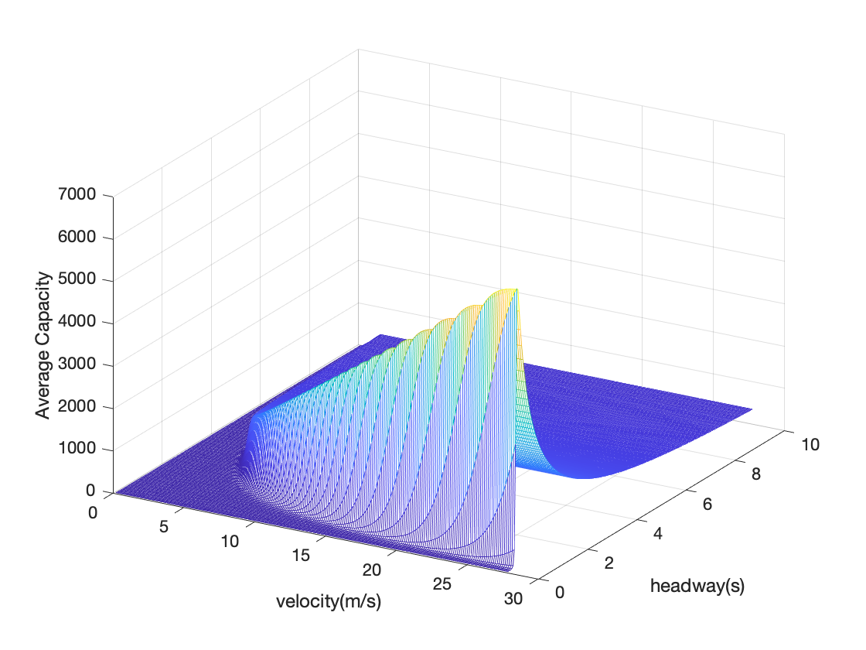
2. Model – Collision-inclusive capacity
Total Clearance Time (TCT)
Collision-inclusive capacity
reduced flow per collision
expected number of collisions
12

Slide 13
3. Discussion – Parameters
Length of a vehicle ($l$)
Safety (-) Capacity (-) → Compact vehicles may be more favored.
Precision of observation($σ_{O}$)
Safety (+) Capacity (+) → More precise sensors lead to safer traffic and thereby contributing to greater traffic capacity and overall benefit.
Time step ($τ$)*
Contribution to headway. (Could be neglected for general values.)
Number of updates of a discrete system. Negative to capacity sorely but allow larger $w$.
Size of sliding window ($w$)*
Contribution to headway. (Could be neglected for general values.)
Error propagation from perception to motion. Positive to both safety and capacity but reduces sensitivity in dynamic scenes.
* See our latest paper for more details.
13

Slide 14
3. Discussion – Suggested control on variables
Set capacity $s(v,h)$ as the goal of optimization:
Two-stage: $h$ controlled by single vehicle and $v$ decided by the platoon.
Derivative:
(*) For most of cases, $S_{v}(h)$ decreases first and then increases. The only solution to $S_{v}^{′}\left(h\right)=0$ exists and serves as the optimal $h^{∗}$.
* See our latest paper for proof and more details.
14

Slide 15
3. Discussion – Suggested control on variables
Set capacity $s(v,h)$ as the goal of optimization:
Two-stage: $h$ controlled by single vehicle and $v$ decided by the platoon.
(*) As long as a $h^{∗}$ exists, $S(v,h^{∗}(v))$ monotonically decreases. The original capacity function’s monotonically increasing suggests that driving as fast as possible only when under reasonable limits by road conditions, such as the curvature, slope, unevenness, etc.
* See our latest paper for proof and more details.
15

Slide 16
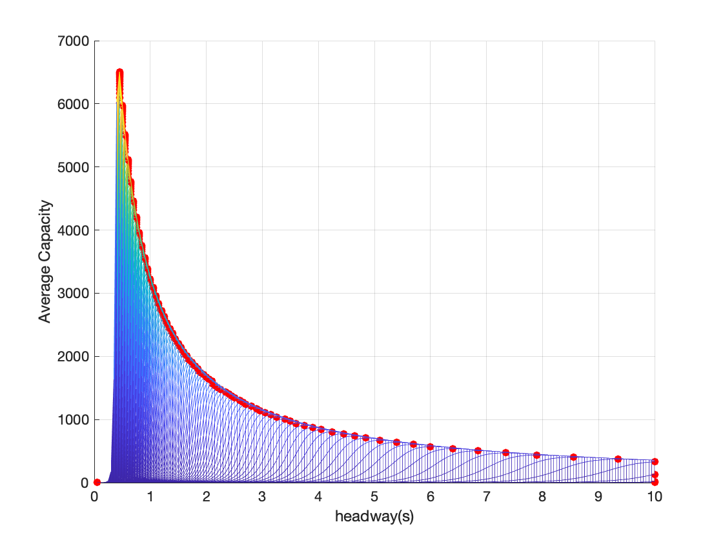
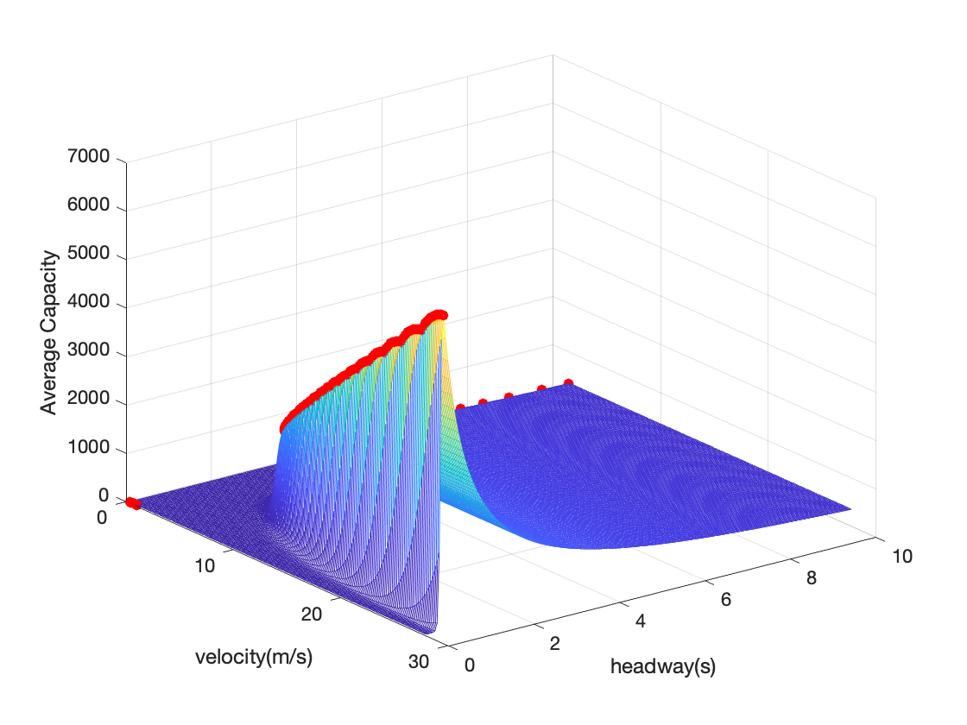
3. Discussion – Suggested control on variables
Optimal control on headway
General suggested control
16

Slide 17
3. Discussion – Generalization
From Car-following to other scenarios
error propagation
(Localization)
(Decision-making)
(Position with uncertainty)
safety measurement
collision-inclusive capacity
As long as AV systems and the traffic environment are modeled,
safety performance and collision-inclusive capacity could be analytically derived.
17

Slide 18
4. Conclusion
Model
Robotic error: from perception to position uncertainty, leading to possible collisions
Safety: integrated collision probability
Capacity: average collision-inclusive capacity reduced by collision blocks
Discussion
Parameters: simple with vehicle length and perception precision, but complex with time step and size of sliding window
Optimal control: locally optimal control on headway, and monotone relationship with speed
Generalization: from the simple car-following to more general scenarios
Future plan
Consider more realistic high-order models to include random acceleration and speed;
Reveal the perceptual error in practice and validate the model by experiments;
Conduct optimization with goals and constraints of realistic meanings based on our model.
18

Slide 19
Thank you
for your attention
LI, Hangyu
hangyu.li@connect.ust.hk
Advised by Dr. SUN, Xiaotong
CTS2022 August 15-16
Intelligent Transportation Thrust
Systems Hub, HKUST(GZ)

